Slide 1
Performance
COMP6452 Software Architecture for Blockchain Applications
Helen Paik
| Senior Lecturer @ CSE, UNSW
| Visiting Senior Research Scientist @ AAP team, CSIRO Data61
h.paik@unsw.edu.au

Slide 2

Outline
Performance
Latency
Transaction Inclusion in Public Blockchain
Simulating Latency
Throughput

Slide 3
Performance Overview

Slide 4
ISO/IEC 25010:2011 Quality Model
Functional suitability
Functional correctness
Functional complete-ness
Performance efficiency
Capacity
Resource utilization
Functional appropriate-ness
Time behavior
Compatib-ility
Interop-erability
Co-existence
Usability
Operability
User error protection
Reliability
Availability
Recoverab-ility
Maturity
Fault tolerance
Security
Integrity
Confidential-ity
Non-repudiation
Accountab-ility
Authent-icity
Maintain-ability
Modularity
Reuseability
Modifiab-ility
Testability
Analyzab-ility
Portability
Installability
Replace-ability
Adaptability
Notes:
International standards for evaluation of software quality
Blockchain has good and bad quality

Slide 5
Performance-Related Considerations
Background
Sustained
Increasing
Stress
Standard benchmarks
Representative?
Production
…
Network
Memory
CPU
Disk
…
Load
Resources
System
Scalability
Latency
Throughput
Timeliness
…
Performance
Resource Utilization
Capacity
Bottlenecks
Efficiency
Notes:
10. Performance

Slide 6
Some Important Varieties of Performance
Latency
How quickly does the system respond to a request?
Throughput
How many requests can the system process in a fixed unit of time?
Timeliness
Will the system always process a request in a specified time window?
Scalability is an orthogonal issue
How does <performance> change under increasing load & system resources?
(Can also be interested in response when decreasing resources, under variable load)

Slide 7
To Understand Performance, You Need Measurements
Application-Level measurements
Overall performance; check requirements met; validate results from detailed models
Component-Level measurements/ Micro-benchmarking
Piece-wise drivers of performance; observe interactions; identity bottlenecks
Load testing – check system response & utilisation under increasing load
Stress Testing – check maximum capacity; find resource bottlenecks
Soak Testing – check system response under long-duration load
“Benchmarking crimes”
https://www.cse.unsw.edu.au/~gernot/benchmarking-crimes.html

Slide 8
Predicting Performance?
Only needs a design & benchmarks
Highly approximate
Analytic formulae
Highly abstract/simplified models
Quick & dirty
Only needs design & component benchmarks
Simulation
Uses a model; many abstractions/simplifications
Only needs a design & benchmarks, but takes work
Starts to explore variation & interactions
Monitoring
Needs real deployed system
Needs a monitoring framework
Most valid results; e.g. actual effects!
Needs a real deployed system
Most valid results

Slide 9
Some Resources in Blockchains
For public blockchains
Cryptocurrency for Transaction Fees
Can affect probability of transaction inclusion (impacts transaction latency)
Mining difficulty for Proof of Work
Gas & Block Gas Limits (e.g. in Ethereum)
More of an Availability problem as discussed next week
Network capacity including speed of light for global transaction & block propagation
Impacts consensus for transaction inclusion latency
Transaction throughput capacity
Latency will be impacted when system is overloaded beyond capacity
For private blockchains / running a node for public blockchain
Normal cloud/enterprise server & network resource considerations

Slide 10
Latency

Slide 11
Transaction Inclusion Time in Public Blockchain…
mining
mining
Timeline
(not to scale)
t0 start mining on previous candidate block
t1
txn sent
t2
miner includes txn in candidate block
t3
txn is observed in new mined block
interblock time / 2
+
interblock time

Slide 12



Student Task
How long does it take to get a transaction committed in Bitcoin?
Assume 10 minutes interblock time and 6 confirmations

Slide 13
… Plus Extra Small Bits of Time
Timeline
(not to scale)
t1
txn sent
t3’
txn is observed in new block
t1’
txn arrives at miner
t2’
miner includes txn in new candidate block
t0 prev candidate block
t3
block is mined
t2
block is mined
https://ethstats.net/
txn propagation time
+
interblock time / 2
+
block prep time
+
interblock time
+
block propagation time

Slide 14
… Also, Major Sources of Variation in Latency
Probability of txn inclusion?! May have to wait for another block! Also, affected by fees…
Timeline
(not to scale)
Arrival time within mining window?
t0 start mining on previous candidate block
t1
txn sent
t2
miner includes txn in candidate block
t3
txn is observed in new mined block
Previous interblock time?
Current interblock time?

Slide 15
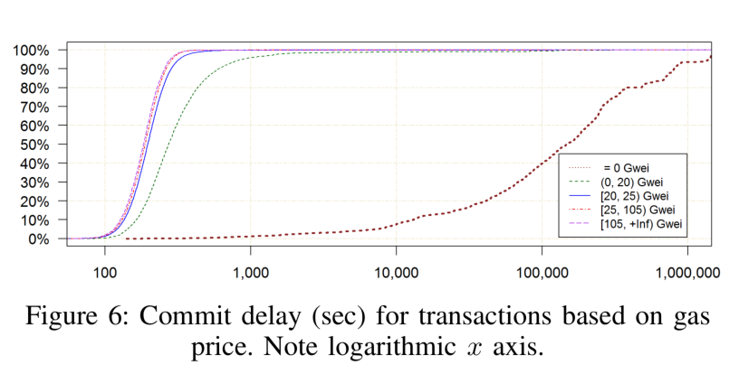
Upshot is High Variation of Latency
Not 1.5 x interblock time; in practice more like ~1.9 x inter-block time?
But with a lot of variation! Some caused by txn fee, gas fee, etc
You need to design your system to cope with this to meet requirements
N.B.: with 11 “confirmation blocks” adding a large “constant”-ish factor on the main cause of difference in latency variation
Notes:
Even though blockchain replace the need of trusted third party, the latency of blockchain can be a major drawback. In a blockchain using Nakamoto consensus, to confirm a transaction, it needs to be included in a block, which should be endorsed by dependent blocks, known as confirmation blocks.
On Bitcoin the inter-block time is about 10 minutes and 6 confirmation blocks are often used while on the public Ethereum blockchain the average block generation time is about 15s and 12 confirmation blocks are typically recommended. As you can see, the latency incur to the system will be high in magnitudes.
Additionally, Transaction delays can also arise from network delays, the transaction fee offered, the number of transactions being processed, and the strategic decisions made by miners. So, transaction inclusion times can vary widely.
Although longer than in conventional systems, these transaction latencies may be acceptable for some use cases. it will still be important to be able to accurately predict system-level latency during the design phase, to assess the impact of this limitation on system requirements

Slide 16
An Aside: Transaction Inclusion with Proof of Authority in Private Blockchain
Timeline
(not to scale)
Assuming transaction arrives before the small window near end of interblock time where the next block is constructed by the Authority, i.e. t1 < t2
This can be tricky because interblock time tends to be much smaller in private blockchains, but in which case will have lower transaction latency anyway
t0 previous block
t2
“miner” includes txn in candidate block
t1
txn sent
t3
txn is observed in new block
interblock time / 2

Slide 17
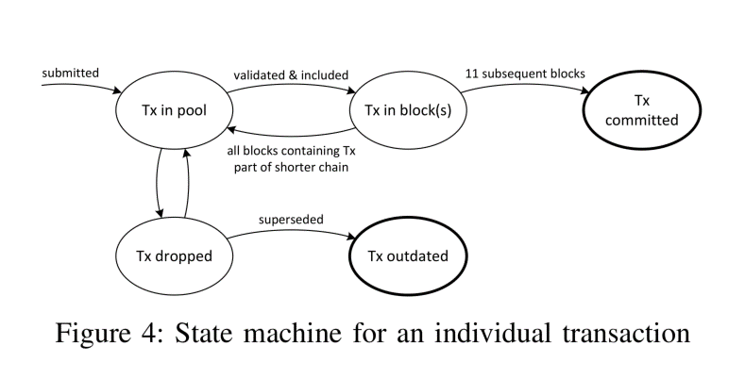
In Public Blockchains, Also Wait for Confirmation Blocks!?
Nakamoto consensus can create “uncle” blocks
Blockchains using Proof-of-Work, Proof-of-Stake, …
Transaction you saw in a block turns out not to have been officially included in the blockchain
Only probabilistic, long-run, transaction inclusion
Can increase confidence your transaction is really included, by waiting for subsequent “confirmation blocks”
For Bitcoin, often people say wait 6 blocks
For Ethereum, often people say wait 12 blocks
(Lower interblock time can increase likelihood of uncles)
Waiting for confirmation blocks increases latency, and increases latency variability

Slide 18
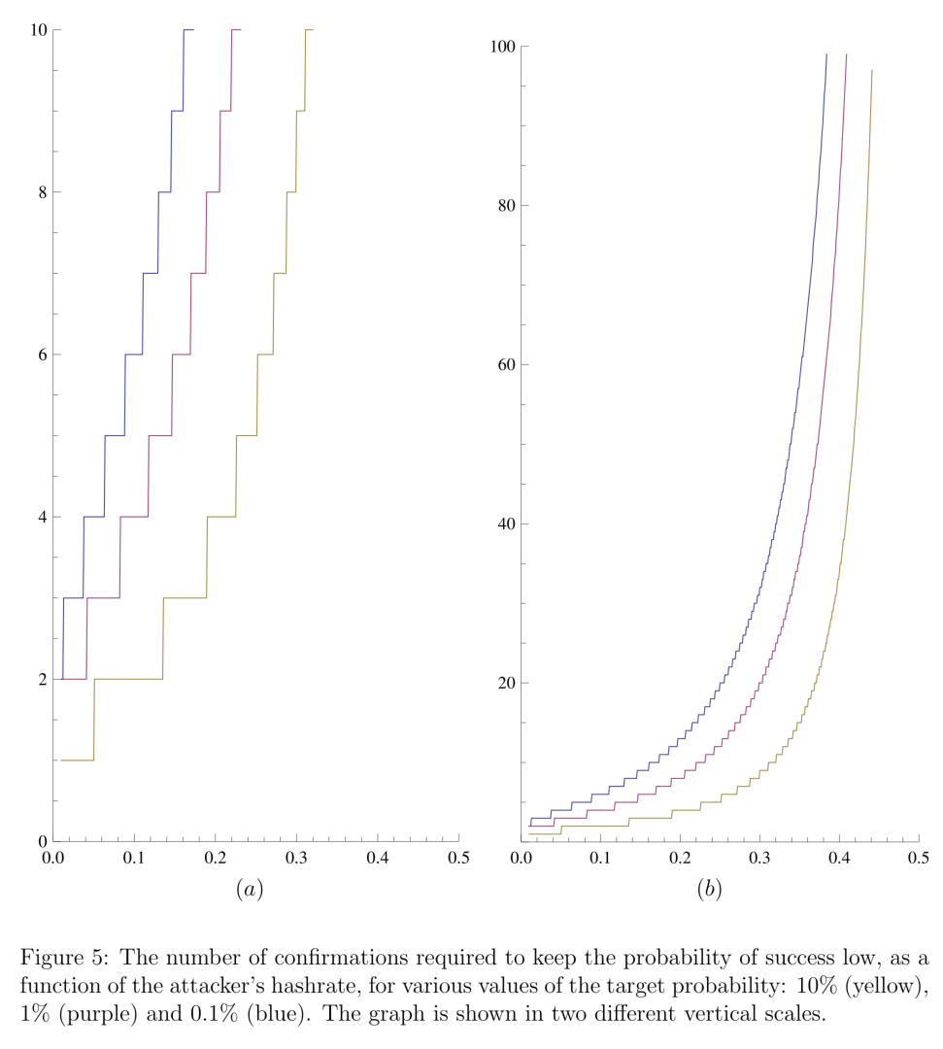
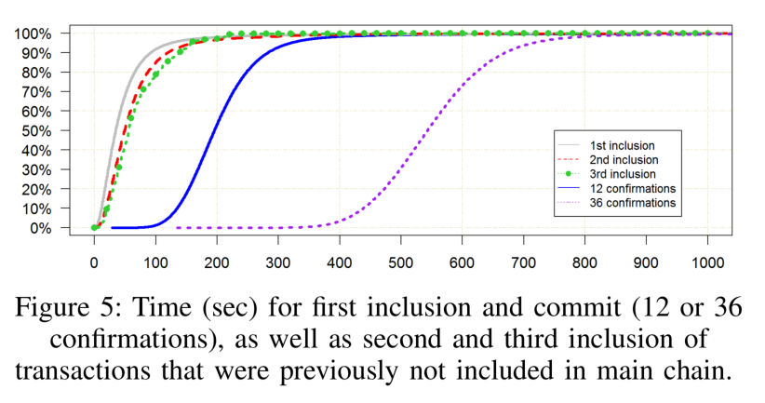


Confirmations: Inclusion Confidence vs Latency
Should be risk-based: how much confidence? vs. how much latency?
“Analysis of hashrate-based double spending”
https://arxiv.org/abs/1402.2009
“On Availability for Blockchain-Based Systems”
https://research.csiro.au/data61/wp-content/uploads/sites/85/2016/08/OnAvailabilityForBlockchain-BasedSystems-SRDS2017-authors-copy.pdf

Slide 19
How Architects Can Influence Transaction Latency
Offer a Transaction fee that meets/exceeds miners’ expectations
Ethereum “fee” is gas price * gas used
Gas price is user-defined
Choose smallest number of confirmation blocks that is “safe” for your application
Use another blockchain (private? or a public blockchain that works “better”?)
Configure blockchain to use other consensus algorithms (PBFT, PoA, …)
Avoid Nakamoto consensus & possibility of uncles, so you can avoid confirmation blocks
Configure blockchain to target a small interblock time
Work off-chain, e.g. using “state channel” design pattern
Design patterns for blockchain applications

Slide 20
Student Task
How can architects influence Tx latency?

Slide 21
An Example: Process Execution on Public Blockchain
(First Activity)
(Fast Automated Response)
(Slow or Manual Response)
…
A process instance can be represented as a smart contract on a blockchain.
Each activity in the process can be a different function in the smart contract API
An off-chain “trigger component” on a cloud or enterprise server watches a blockchain node and invokes the next activity in the process
If activity is automated: fast; otherwise: slow(er) e.g. in response to some manual activity
Notes:
our research group studied the possibility of using blockchain for collaborative business process in order to address the lack of trust problem in collaborative business process.
The idea is to use blockchain and the smart contract functionality to enforce the trustworthiness of the process without having a centralized trusted third party.
In the proposed method, blockchain facilitates collaborative process either of two ways; as a choreography monitor which stores the process execution status and provides immutable data storage or active mediator by coordinating the collaborative process.
smart contracts in a blockchain can not interact directly with the external world, a trigger component connects the processes executing on blockchain to enterprise systems by acting as an agent for an organization. The trigger manages keys, keeps track of the data payload in API calls, and can interact with external services including other databases or web services.
Generally each organization has to deploy it’s own trigger and at least one blockchain full node connected to the blockchain.

Slide 22
Latency of Process Execution on Public Blockchain
1.5 x interblock
+ 2 x interblock
+ activity duration + 1.5 x interblock
Here, the design does not use confirmation blocks.
Quick & dirty!
Assumes averages (median or mean)!
Transactions arrive in the middle of an interblock time window
Uniform average interblock time
(First Activity)
(Fast Automated Response)
(Slow or Manual Response)
…
The first activity will arrive in “the middle” of some interblock time window, so takes 1.5 x interblock times.
If activity response is very fast (in the same interblock time window), it will still be too late to include in the next block, so will take 2 x interblock times.
If the activity response is very slow (longer than the interblock time window), it will arrive in “the middle” of some future interblock time window
Notes:
our research group studied the possibility of using blockchain for collaborative business process in order to address the lack of trust problem in collaborative business process.
The idea is to use blockchain and the smart contract functionality to enforce the trustworthiness of the process without having a centralized trusted third party.
In the proposed method, blockchain facilitates collaborative process either of two ways; as a choreography monitor which stores the process execution status and provides immutable data storage or active mediator by coordinating the collaborative process.
smart contracts in a blockchain can not interact directly with the external world, a trigger component connects the processes executing on blockchain to enterprise systems by acting as an agent for an organization. The trigger manages keys, keeps track of the data payload in API calls, and can interact with external services including other databases or web services.
Generally each organization has to deploy it’s own trigger and at least one blockchain full node connected to the blockchain.

Slide 23
Student Task
How would application-level latency be impacted by using 3 confirmation blocks?

Slide 24
Simulation for Latency Estimation
e.g. using Palladio
Open source, Component-Based
https://www.palladio-simulator.com/home/
Widely used for performance modelling and simulating
UML-like notation
Need to Benchmark Transaction Inclusion on Blockchain
Treat the blockchain as a black box – txns in/txns out
Measure time between submitting a transaction and receiving verification by a given number of confirmation blocks
Not just averages; measure the distribution of times
Also benchmark trigger implementation that invokes txns
“Predicting latency of blockchain-based systems using architectural modelling and simulation” https://research.csiro.au/data61/wp-content/uploads/sites/85/2016/08/2017-ICSA-Blockchain-Latency-Sim-authors_copy.pdf
Notes:
We used palladio component model for modelling. Palladio has been used and studied in the literature thoroughly about the accuracy and the capability of modelling different kind of systems. We shows a methodology to use palladio component model for predicting blockchain based system performance.
We used existing methods so that the non blockchain components can be modelled as it is using existing methods while we suggest how to model the latency of blockchain based components.
For this paper, we used Ethereum as the blockchain and we set up a private blockchains for different configurations. Then we benchmarked the blockchain for obtaining the parameters need to construct palladio models.

Slide 25
Simulation for Predicting Latency
Architecture
Model Construction
Simulation
Micro Benchmarking
Notes:
So we benchmarked the properties of blockchain and constructed performance models and used constructed models for predicting system level latencies and to compare the latency impact to the overall system incur by introducing blockchain to the system.

Slide 26
Benchmarking Transaction Commit Time
Transaction Inclusion Time: Time Taken from Submitting transaction until transaction get included in blockchain
Notes:
A key parameter for our architectural performance model is the transaction commit time: the time taken from submitting a transaction until we have sufficient confidence that the transaction has been successfully included in the blockchain.
We start the clock on submission of a transaction, and stop the clock when the broadcasting node receives a sufficient number of confirmation blocks after receiving a block which includes the transaction.

Slide 27
Example Incident Management Business Process
Notes:
To evaluate our models, we implemented the business process shown here using blockchain as a mediator for managing process. There is a resolution rate at every stage and it not resolve the issue at that stage passed to the next stage so on.

Slide 28
Example Usage Model
Usage diagram
Notes:
We constructed palladio models accordingly. We injected measurement to constructed models as probability distribution functions gathered. Here I have show here the usage diagram which defines the business process execution flow. You can find model construction in detail in our paper.

Slide 29
Example Results & Checking vs. Real System
 | Measured | Simulated | Relative error
Median latency | 136s | 134s | 1.6%
Standard error of median (SEM) | 1.27 | 1.07 | -
95th Percentile | 274s | 248s | 9.4%
99th Percentile | 373s | 329 | 11.5%
Notes:
So, We simulated the models and compare the simulated results with the actual implementation. Here you can see the measured and simulated system level latencies. We gathered 1000 samples for each and we were able to achieve good results. Relative error of median was 1.6% for this experiment. For defining latencies, as this is a long tail distribution, 95% and 99 percentiles are also important and we were able to achieve 9.4% and 11.5% for those measures accordingly.

Slide 30
Throughput

Slide 31

Throughput
How many transactions can you process in a unit of time?
e.g. Visa card processing, 2000 tps daily average, peak capacity ~60000 tps
https://www.visa.com/blogarchives/us/2013/10/10/stress-test-prepares-visanet-for-the-most-wonderful-time-of-the-year/index.html
Bitcoin has poor throughput capacity (3 to 7 tps)
Ethereum has poor throughput capacity (7 to 25 tps)
https://medium.com/coinmonks/understanding-cryptocurrency-transaction-speeds-f9731fd93cb3
You as an individual user are unlikely to create system overload!
But, you need to understand trends in ecosystem utilisation and bottlenecks
e.g. At one point in time, about a third of transactions on Ethereum were for cryptokitties

Slide 32
Throughput Limits
Transactions per block * blocks per second = Transactions per second
Bitcoin limited by block size, and average transaction size
1000000 Bytes / 495 Bytes / 600 seconds = 3.37 tps
(growth in use of segwit and other txn size optimisation can double? throughput)
Ethereum limited by block gas limits, and average transaction gas
8000000 gas block limit / 76000 gas / 15 seconds = 7 tps
Limits are there mainly to control block propagation times
To control likelihood of uncles, DDoS, and control centralisation of mining

Slide 33
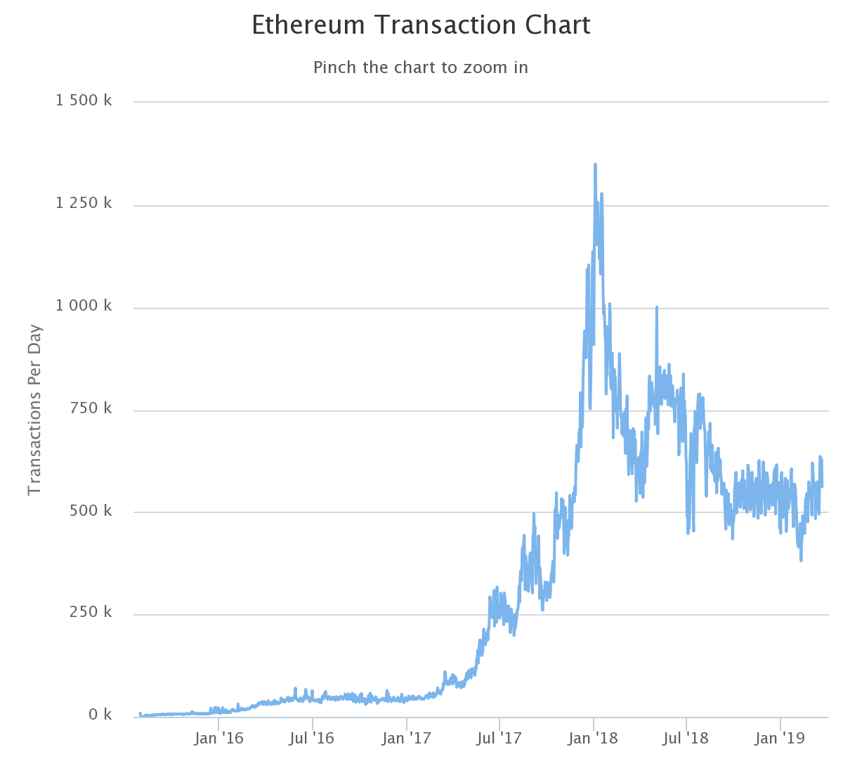
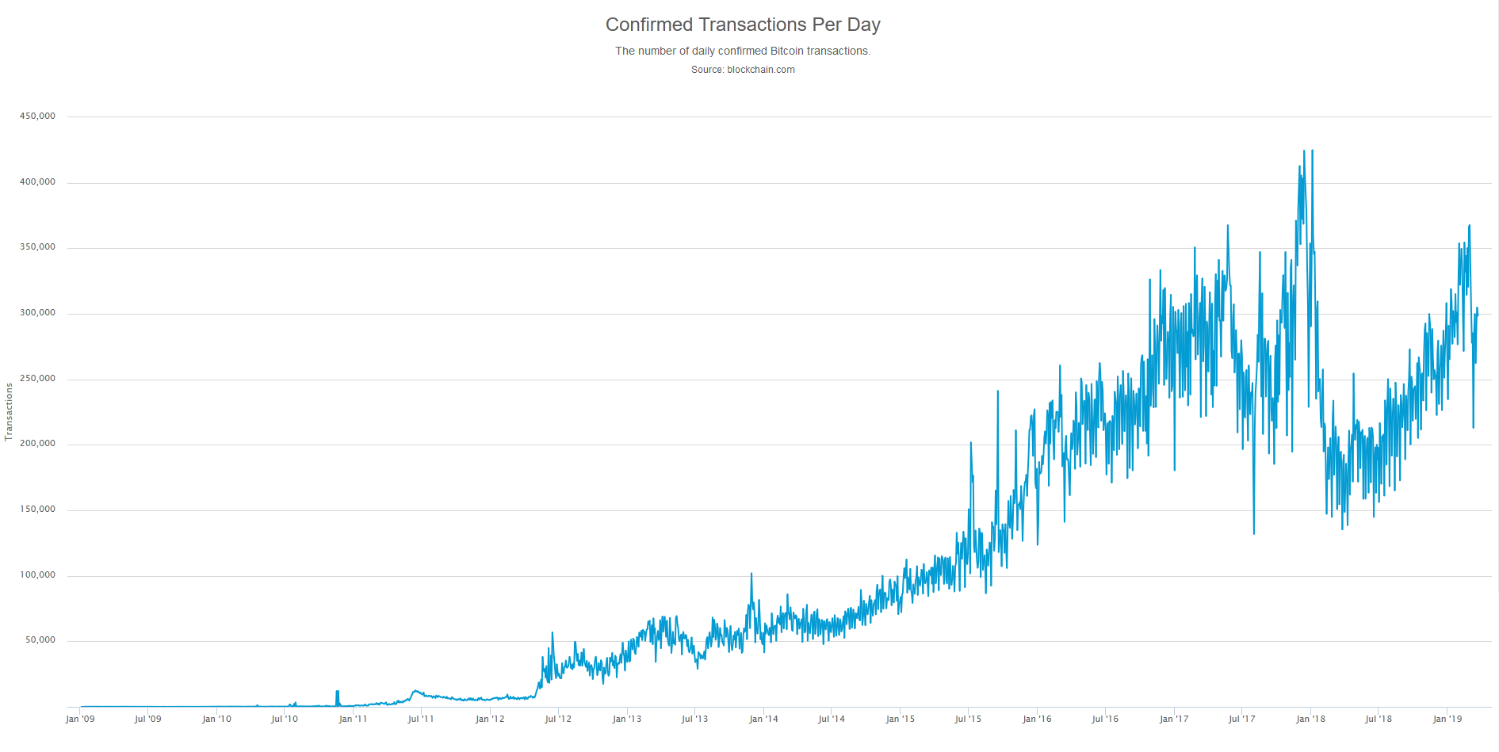
Growth in Throughput
3.3 tps
10 tps

Slide 34
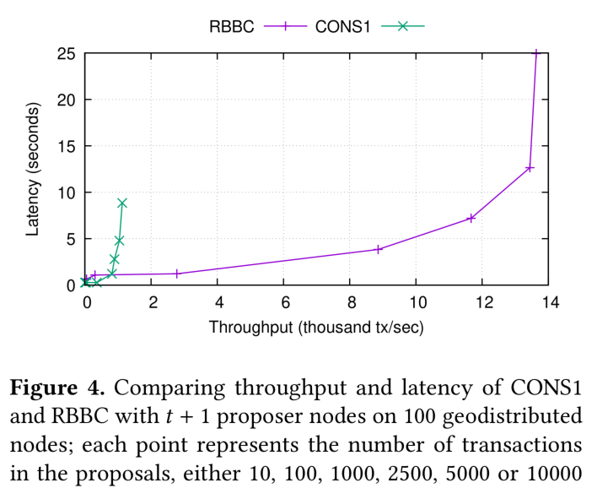
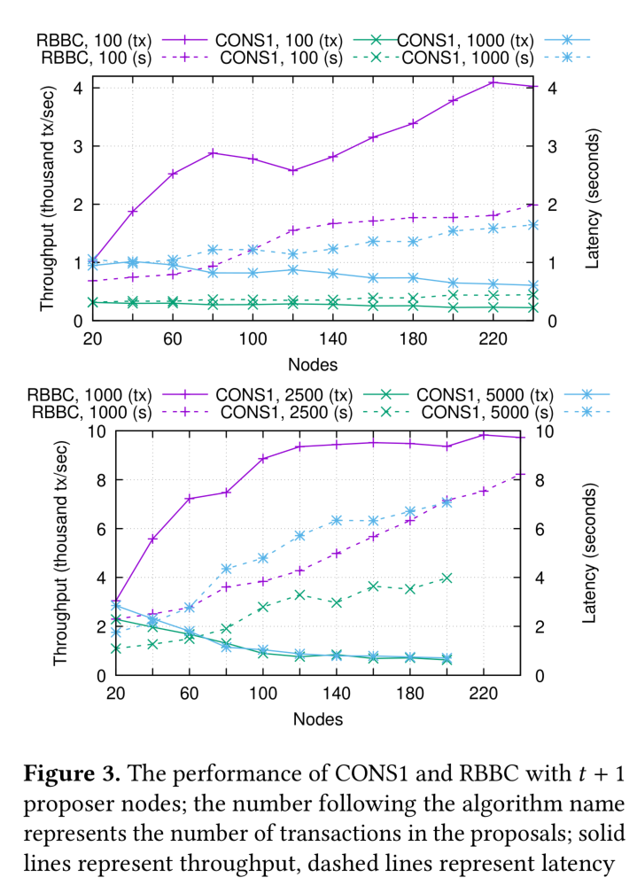
Red Belly Blockchain Throughput
“Evaluating the Red Belly Blockchain”
http://arxiv.org/abs/1812.11747

Slide 35
DAGs, Sharding, etc
Blockchains enforce a strictly ordered single list of transactions
Critical for integrity of transfer of digital assets (no “double spend”)
But creates a throughput bottleneck
DAGs (“tangles”), e.g., IOTA, …
Not a list, but a directed acyclic graph
Multiple heads (“tips”), each processed mostly concurrently, repeatedly diverging/merging
Hard to maintain data integrity across the heads – transactions can conflict!
Can, e.g. resolve a bit like like Nakamoto consensus – tentatively included until merged
Sharding, e.g. future Ethereum?
Split chain into smaller chunks (horizontal partitioning), each processed mostly concurrently
Might increase Ethereum throughput by 1000x
Hard to maintain data integrity across the shards
Shards interact with a protocol only when necessary, to maintain global integrity
Networks or hierarchies of interrelated blockchains
e.g. geographically-sharded IoT blockchain networks

Slide 36
Student Task
How can architects influence throughput?

Slide 37
How Application Architects Can Influence Transaction Throughput
Use another blockchain (private? or a public blockchain that works “better”?)
Configure blockchain to use other consensus algorithms (PBFT, PoA, …)
Sharding, DAGs
Configure blockchain to use a larger block size, or smaller interblock time
If you don’t need exchange of digital property, consider networks of blockchains, DAGs, …
If you have to use a specific public blockchain, then focus on how you use the blockchain, and focus on other areas of the application architecture
Reduce the data you put on-chain (sampling, digests, hashes, …)
Do more work off-chain, e.g. using “state channel” design pattern, to be discussed in later lectures

Slide 38
Summary

Slide 39
Summary: General
(Load × Resources) → (Performance × Resource Utilisation)
Measurement is critical to understand all this in practice
Kinds of Performance: Latency vs Throughput (vs Timeliness)
Blockchains have high latency and high variability of latency
Variability is significantly affected by choice of consensus mechanism
Number of confirmation blocks are a risk-based decision
Can avoid them if you don’t use Nakamoto consensus/probabilistic commits
Many Blockchains have poor throughput
Affected by ledger structure and consensus mechanism
Do you need exchange of digital assets?
If you don’t need a global integrity property, you can avoid major bottlenecks

Slide 40
Summary: Predicting Latency
For a single transaction on public blockchain latency = 1.5 * interblock time
Assuming transaction is included ASAP
Ignoring transaction/block propagation times, and block preparation time
On average (ignoring variation in interblock time, arrival time)
For sequence of n > 1 transactions on public blockchain latency = 1.5 * interblock time + (n-1)*2 interblock time
Assuming next transaction is injected immediately into the interblock window
Can use simulation for more precise prediction of application-level latency
Can explore latency variation, interactions between components, and bottlenecks
Or, use measurement and test of real(istic) system under real(istic) load

Slide 41
Thank You
Helen Paik
| Senior Lecturer @ CSE, UNSW
| Visiting Senior Research Scientist @ AAP team, CSIRO Data61
|h.paik@unsw.edu.au

